Slide 1
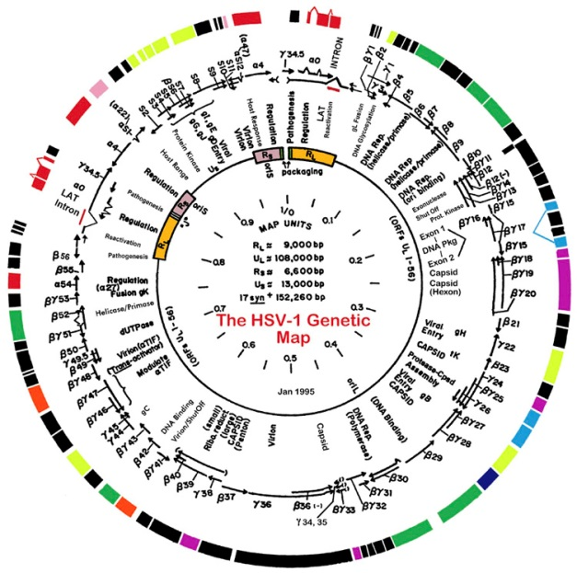
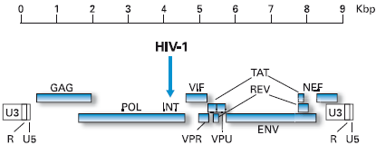
Lecture 6
Viral replication
Gene expression and genome rep

Slide 2
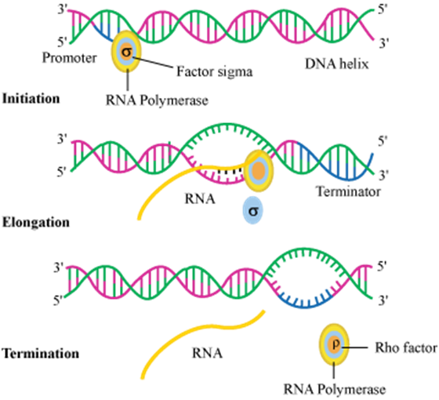
Viral replication
Transcription/translation overview
• Review from Bio I/genetics
- Cellular transcription
- Information in DNA is copied into a complementary RNA

Slide 3
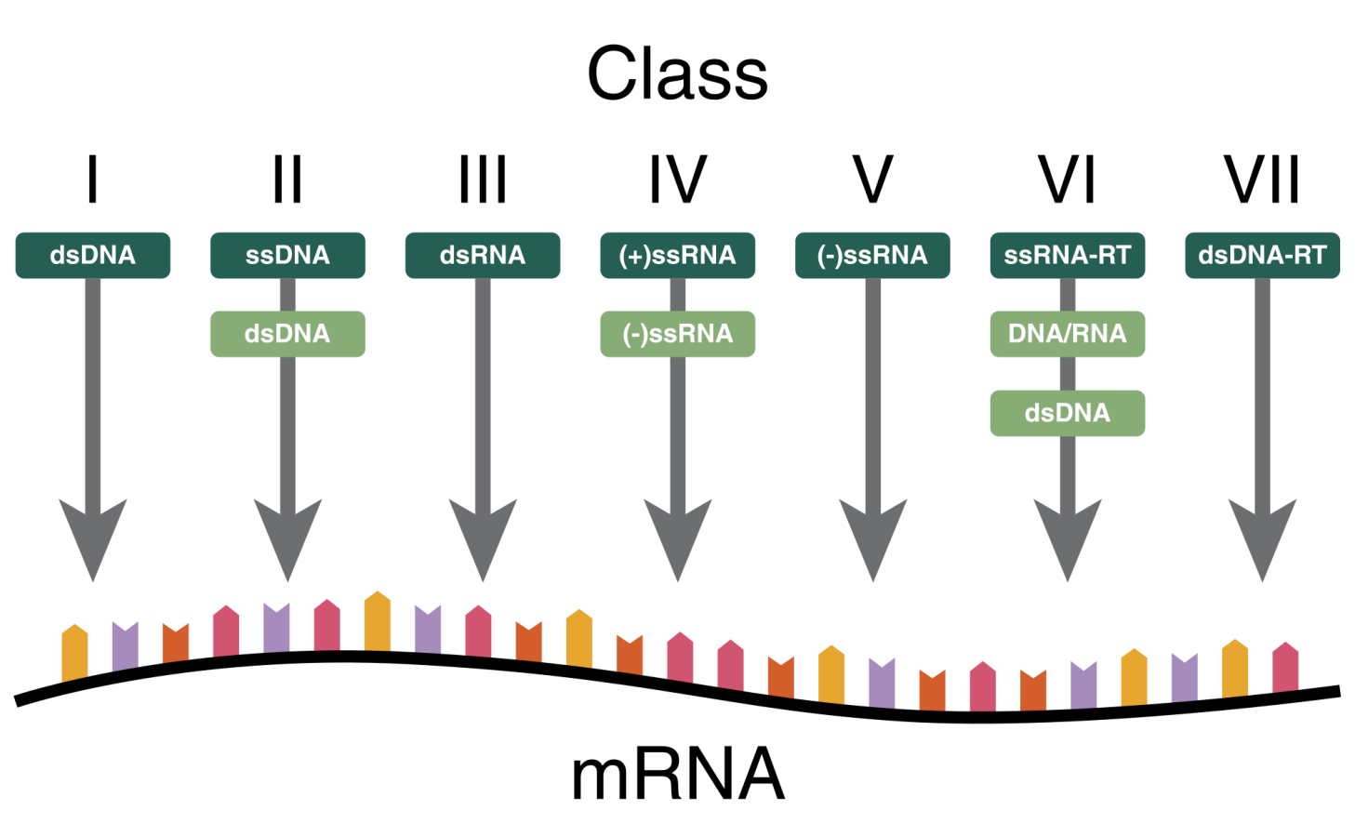
Viral replication
Baltimore classification revisited
• Viruses can have drastically different looking genomes
- Creates major differences in how they produce mRNA
- Each class do transcription a bit differently

Slide 4
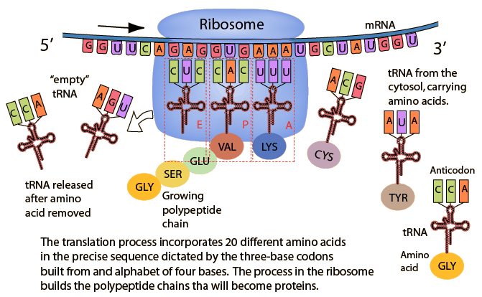
Viral replication
Transcription/translation overview
• Review from Bio I/genetics
- Cellular translation
- Ribosome reads mRNA codon sequence and makes a
polypeptide → SAME FOR ALL VIRUSES!!

Slide 5
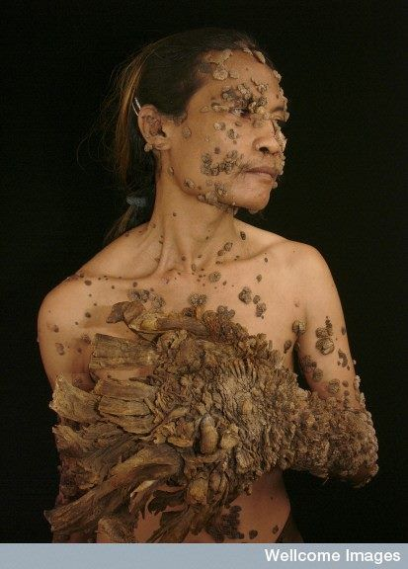
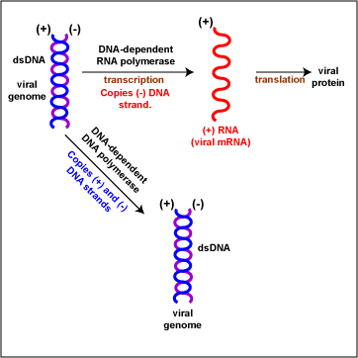
Viral replication
Transcription – dsDNA viruses (I)
• Double-stranded DNA viruses
- Have genomes that resemble that of cells
- Examples: Poxviruses, herpesviruses, adenoviruses, and
papillomaviruses, many phages
- Viral genome must enter the
nucleus where necessary enzymes
are located
- Use cellular DNA-dependent RNA
polymerase for transcription
- Review enzyme naming!

Slide 6
Viral replication
Genome rep – dsDNA viruses (I)
• Double-stranded DNA viruses
- Since its genome looks just like ours, it uses the same
enzymes that our cells use to copy its genome
- DNA-dependent DNA polymerase
- Cellular DNA polymerases have
excellent proofreading abilities
- Correct any mistakes
- Error rate is only 1/10 million
- dsDNA viral genomes rarely mutate
- Immunity is easier for us
- Vaccines can be more effective

Slide 7
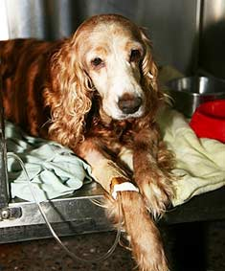

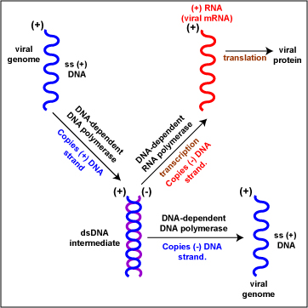
Viral replication
Transcription – ssDNA viruses (II)
• Single-stranded DNA viruses
- All DNA viruses must go into the nucleus, including ssDNA
- Transcription of DNA requires a double-stranded molecule
- ssDNA viruses must use cellular
DNA-dependent DNA polymerase
enzymes to make the 2nd strand
first
- Then uses cellular DNA-dependent
RNA polymerase for transcription
- Examples: Parvoviruses and some
phages

Slide 8
Viral replication
Genome rep – ssDNA viruses (II)
• Single-stranded DNA viruses
- Genome replication requires the same cellular DdDp that
dsDNA viruses use
- Low error rate, low mutation rate for the viruses
- dsDNA intermediate used as a
template for transcription is also
used for genome replication
- Only one of the two strands is
copied
- Lots of new + ssDNA genomes
produced

Slide 9
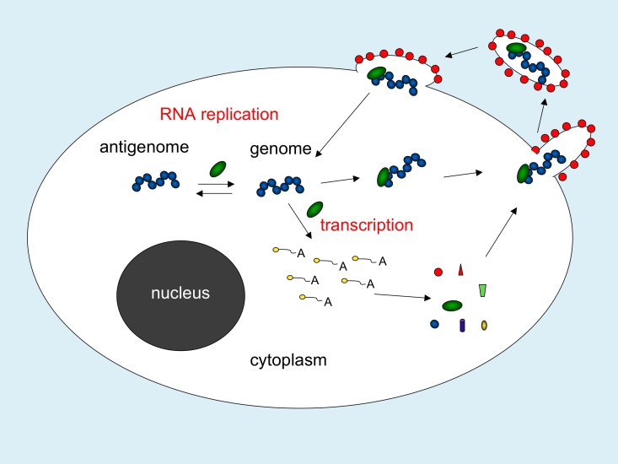
Viral replication
Transcription – RNA viruses
• RNA viruses overview
- RNA viruses usually have no need for the nucleus to
complete transcription, translation, and genome replication
- All enzymes required are in virion or cytosol
- No enzyme exists in the cell
that can make RNA from RNA
- RNA viruses have a problem
for transcription and genome
replication
- Must make their own RNA-dependent RNA polymerase
- These enzymes usually lack proofreading ability
- Much more error prone than cellular enzymes

Slide 10
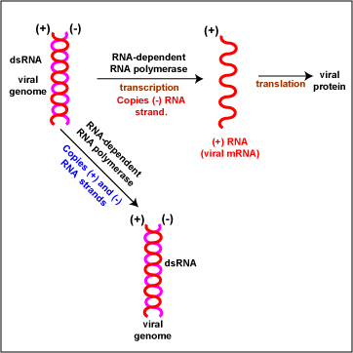
Viral replication
Transcription – dsRNA viruses (III)
• Double-stranded RNA viruses
- RdRp transcribes one of the two strands (-) into a positive
sense capped mRNA
- Doesn’t just simply separate the two and use one strand
- These viruses often have segmented
genomes
- Will have to repeat transcription
with each segment
- Examples: Reoviruses like rotavirus
and bluetongue virus

Slide 11
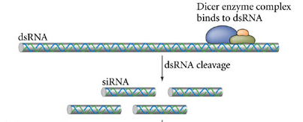
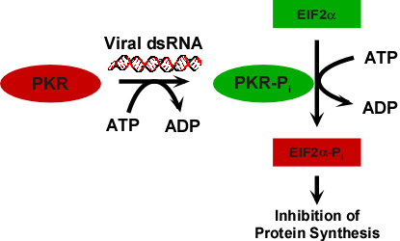
Viral replication
Transcription – dsRNA viruses (III)
• Double-stranded RNA viruses
- dsRNA doesn’t exist normally within cells
- Most cells have developed mechanisms to detect and
destroy dsRNA as a host defense
- Examples: Dicer, PKR, MDA5
- dsRNA viruses have evolved with
these immune defenses
- Will transcribe RNA genome
while still w/in the capsid in
the cytosol (before uncoating)
- Must have RdRp within the virion
itself

Slide 12
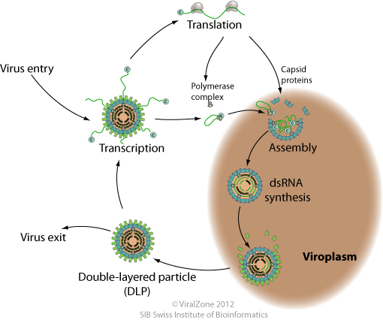
Viral replication
Genome replication – dsRNA viruses (III)
• Double-stranded RNA viruses
- Some of the + sense RNA strands made from transcribing
the original dsRNA genome will also get packaged into
new capsids
- Within the new capsid, RdRp will make the 2nd strand (-)
to create full dsRNA genomes
- Done to hide dsRNA from
host enzymes
- Original dsRNA genome remains
intact → new virions, new dsRNA
- This is conservative genome
rep (rather than semi-conservative)

Slide 13
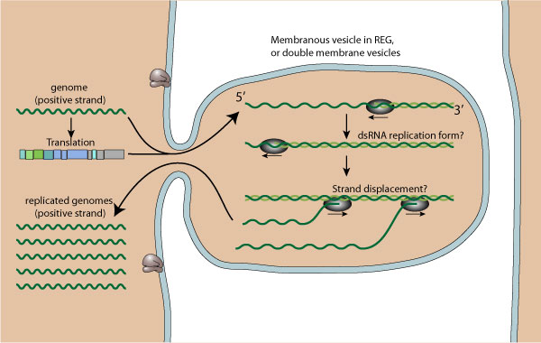
Viral replication
Transcription – ssRNA (+ sense) viruses (IV)
• Positive sense RNA virus genomes resemble mRNA
- Upon entry, genome is translated directly by ribosomes
- One of viral proteins made is the RdRp (don’t need it
packaged into virion)
• RdRp then takes the genome into a isolated pocket of RER
membrane and transcribes it
- Now have a dsRNA (protected)
• RdRp then uses that to make
more + sense strands (mRNA)
- Those new mRNAs are used
to make more viral protein and
serve as new genomes

Slide 14
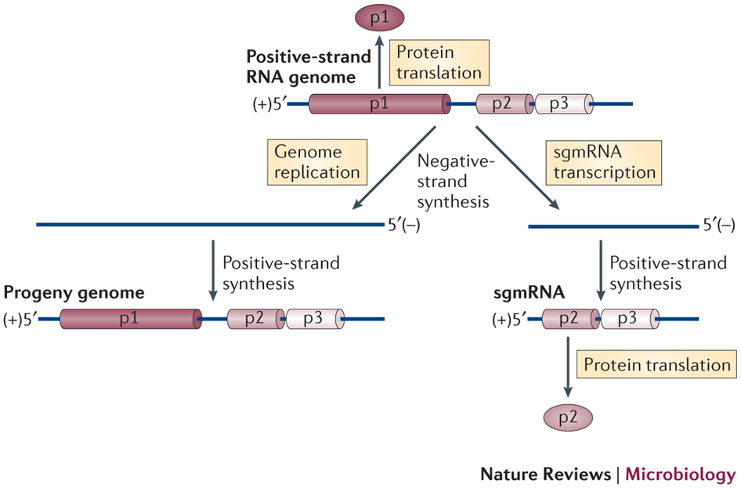
Viral replication
Trans/genome rep – ssRNA (+ sense) viruses (IV)
• In some viruses, RdRp enzymes make different looking
+ sense RNAs from the dsRNA intermediate
- It makes full length + sense RNAs → new genomes
- It makes shorter (subgenomic) + sense RNAs → used to
make certain new viral proteins
• Examples of + sense ssRNA viruses
- Picornaviruses (polio)
- Coronaviruses (SARS)
- Flaviviruses (yellow fever,
Dengue, Zika)
- Norwalk (noroviruses)
- Togaviruses (Rubella)

Slide 15
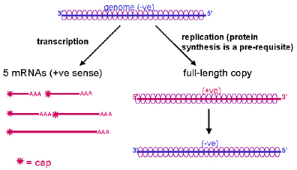
Viral replication
Transcription – ssRNA (- sense) viruses (V)
• Negative sense ssRNA genomes do not resemble mRNA
- Must be transcribed into + sense strands by an RdRp that
is packaged into the virion
- Will do so in a protected membrane invagination
- Blocks exposure of dsRNA
- Will make a series of short
capped + sense strands that
serve as mRNAs for new viral
protein production
- The viral mRNAs made will
be capped like cellular ones

Slide 16
Viral replication
Genome rep – ssRNA (- sense) viruses (V)
• The RdRp will make a full length + sense RNA from the -
sense genome
- That + sense strand will then be copied by the same
RdRp into many copies of - sense genomes

Slide 17

Viral replication
Transcription – ssRNA (- sense) viruses (V)
• Includes a large number of viruses relevant to humans
- Orthomyxoviridae – influenza viruses
- Rhabdoviridae – VSV and rabies
- Paramyxoviridae – measles, mumps
- Filoviridae – Ebola, Marburg
- Bunyaviridae – hantaviruses
• No benefit or hindrance for dsRNA, ssRNA
(+), ssRNA (-) in terms of transcription or translation
- All completely take over cellular transcription and all
can cause disease in host
- All have to use a relatively bad RdRp enzyme that lacks
proofreading → RNA viruses mutate very well

Slide 18
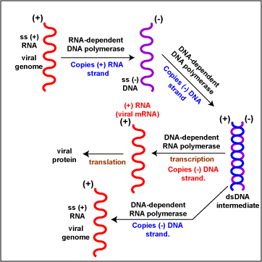
Viral replication
Transcription – ssRNA retroviruses (VI)
• Retroviral genomes in the virion is positive sense ssRNA
- Unique RdDp enzyme called reverse transcriptase
copies the ssRNA genome into a complementary ssDNA
(-) strand
• Reverse transcriptase then adds the
2nd, complementary DNA strand to
the ss copy just made (next slides)
- Now have a normal looking
dsDNA genome
• dsDNA viral genome is inserted
into host DNA genome by an
enzyme called integrase

Slide 19
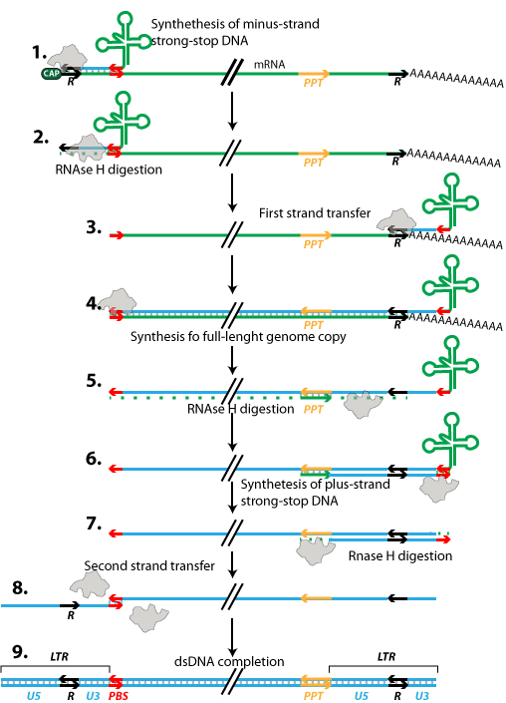
Viral replication
Transcription – ssRNA retroviruses (VI)
• Reverse transcription is a complicated process
- Cellular tRNA binds to primer
binding site at end of viral RNA
- RT adds complementary DNA to
the end
- RT destroys the end of RNA genome
- The newly made small piece of DNA
comes off and switches to the other
end of the same RNA genome
- Called 1st strand switch
- RT finishes making that first
strand of DNA

Slide 20
Viral replication
Transcription – ssRNA retroviruses (VI)
• Reverse transcription is a complicated process
- RT destroys most of the rest of the
RNA genome except one small piece
called PPT
- RT uses the PPT as a primer to begin
making the 2nd DNA strand
- Goes until reaching the end
- That piece dissociates and moves to
the other side of the ssDNA
- Called 2nd strand switch
- RT makes rest of the 2nd DNA strand

Slide 21
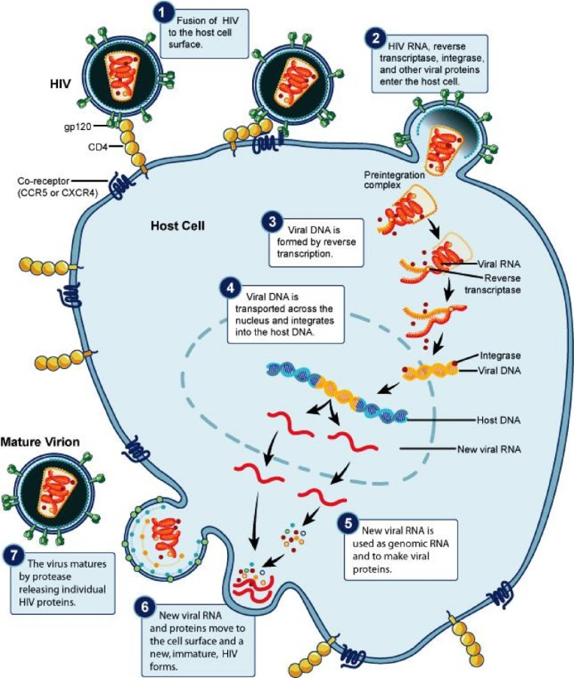
Viral replication
Trans/gen rep – ssRNA retroviruses (VI)
• With viral genome now part of the host genome, transcription
to make new viral proteins proceeds like a dsDNA virus
- Viral and host transcription factors
bind to viral promoters and host
RNA polymerase makes viral
mRNA (+ sense)
- Some of that + sense mRNA made
will be used as new genome for
assembling virions
- The mRNA and new genomes
are identical in structure and
composition

Slide 22
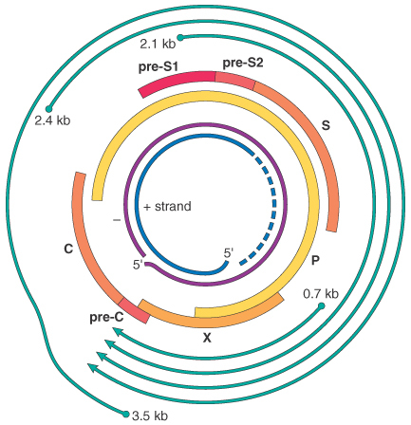
Viral replication
Transcription – DNA “retroviruses” (VII)
• Some DNA viruses possess reverse transcriptase
- Examples: Hepadnaviruses (HBV)
- Doesn’t make logical sense – why not just use host DNA
polymerases to make more viral DNA genomes?
• Viral transcription
- Since the genome is partially dsDNA,
host RNA polymerases (DdRp) come
in and transcribe all viral genes
- In addition, it will transcribe a full-length
mRNA copy of the entire genome
- It will package this mRNA into new capsids

Slide 23
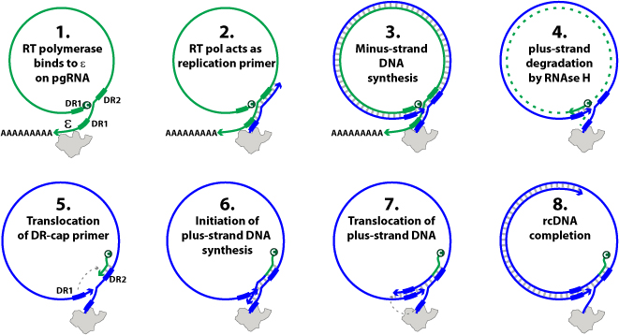
Viral replication
Transcription – DNA “retroviruses” (VII)
• Once inside the capsid (but still in the cell), viral RT will bind
to the packaged mRNA and make a DNA copy from it
- Will make one full strand and a partial 2nd strand of DNA

